Slide 1
Sales Forecasting using Machine Learning
Team Members:
Dhrumil Vadgama (C-238)
Aritro Sengupta (C-232)
Aman Jain (C-241)
Project Mentor(s):
Prof. Sunil Chaudhari

Slide 2
Abstract
Forecasting sales is a common and essential use of machine learning (ML).
Sales forecasts can be used to identify benchmarks and determine incremental impacts of new initiatives, plan resources in response to expected demand, and project future budgets.

Slide 3
Introduction
Predicting future sales for a company is one of the most important aspects of strategic planning.
Our goal is to identify the most important variables and to define the best regression model for predicting our target variable.
Machine learning can help us discover the factors that influence sales in a retail store and estimate the number of sales it will have in the near future.

Slide 4
Methodology
The objective of our project is to develop a statistical Model based on the dataset available.
Step 1 - First we will import modules and load data using pandas.
Step 2 - We will then preprocess the big mart sales data and create new
attributes.
Step 3 - Exploratory Data Analysis of big mart sales
Step 4 - Feature Engineering
Step 5 - We are going to use different models to test the accuracy and
will finally train the whole data to check the score.

Slide 5
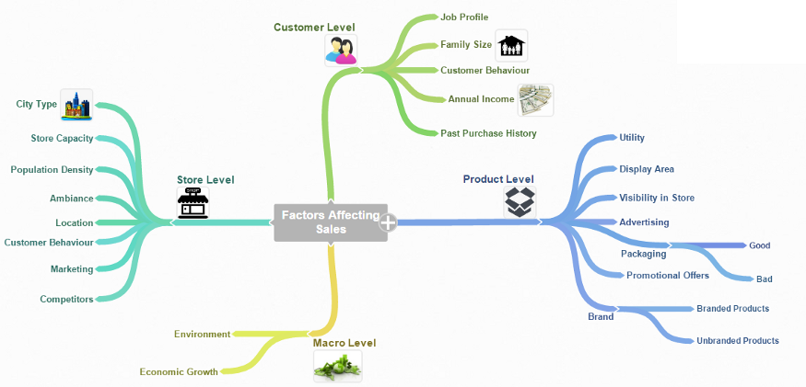
Make Assumptions
To find which possible factors might affect the sales prediction outcome we can first divide the process into four levels: Store level, Product level, Customer level and Macro level.

Slide 6
Dataset Information -
The dataset we will use in this project is downloaded from kaggle. The data scientists at BigMart have collected 2013 sales data for 1559 products across 10 stores in different cities. Also, certain attributes of each product and store have been defined.
Using this model, BigMart will try to understand the properties of products and stores which play a key role in increasing sales.
Link : https://www.kaggle.com/devashish0507/big-mart-sales-prediction

Slide 7
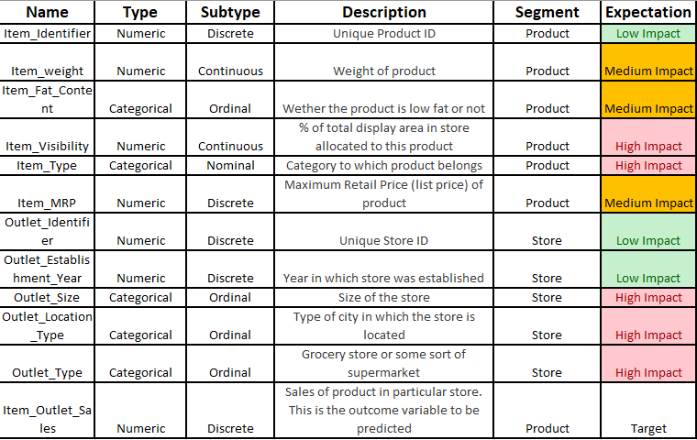

Slide 8
Libraries -
Pandas
matplotlib
seaborn
scikit-learn
Algorithms -
Linear Regression
Ridge Regression
Decision Tree
Random Forest
XGBoost Model

Slide 9
Block Diagram
Import modules and load data using pandas
Preprocessing the sales data
Creation of new attributes
Exploratory Data Analysis of sales data
Correlation matrix
Label Encoding for data preprocessing
Feature Engineering
Model Training & Testing
Evaluation of Model using Test Data

Slide 10
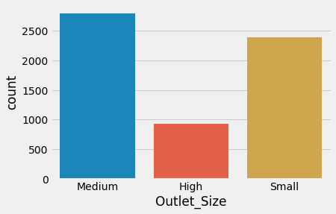
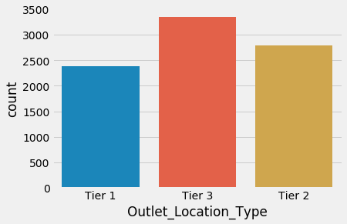
Exploratory Data Analysis
Univariate Analysis

Slide 11
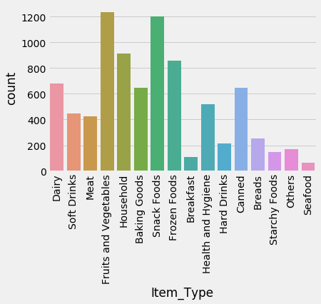
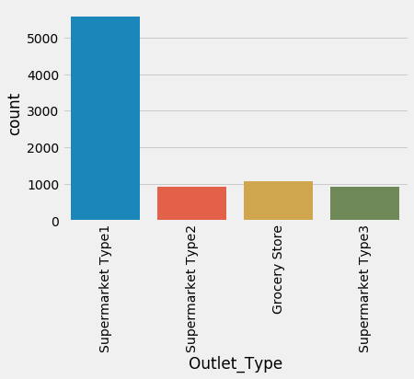
Univariate Analysis

Slide 12
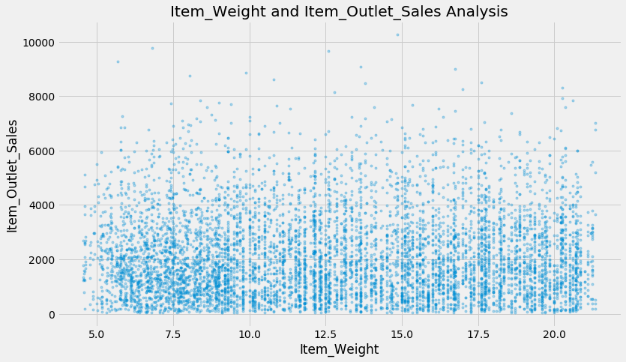
Bivariate Distribution
Item_Weight has a low correlation with our target variable.

Slide 13
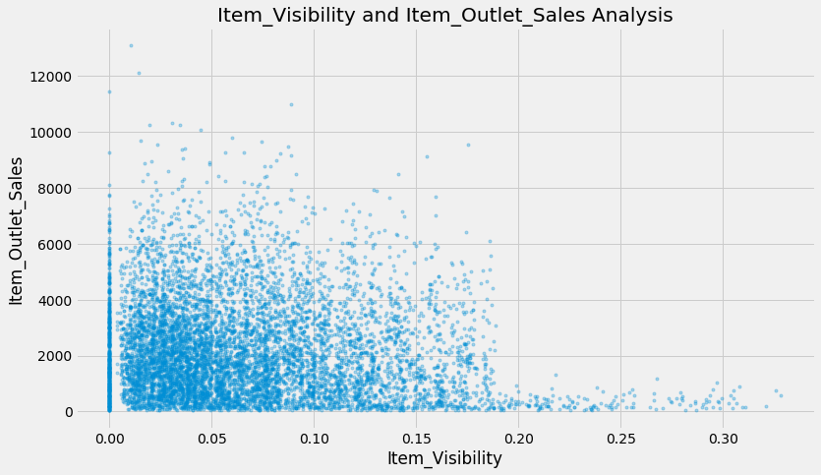
Bivariate Distribution
This plot chart indicate the more visible a product is, the less higher its sales will be.

Slide 14
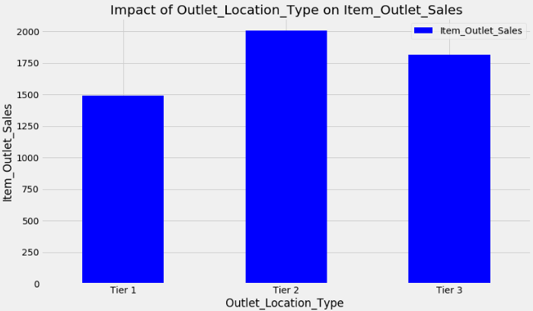
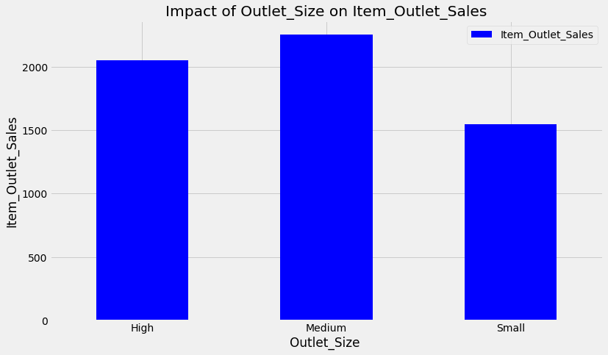
Do Tier 1 cities have higher sales?
Do stores which are very big in size have higher sales?

Slide 15
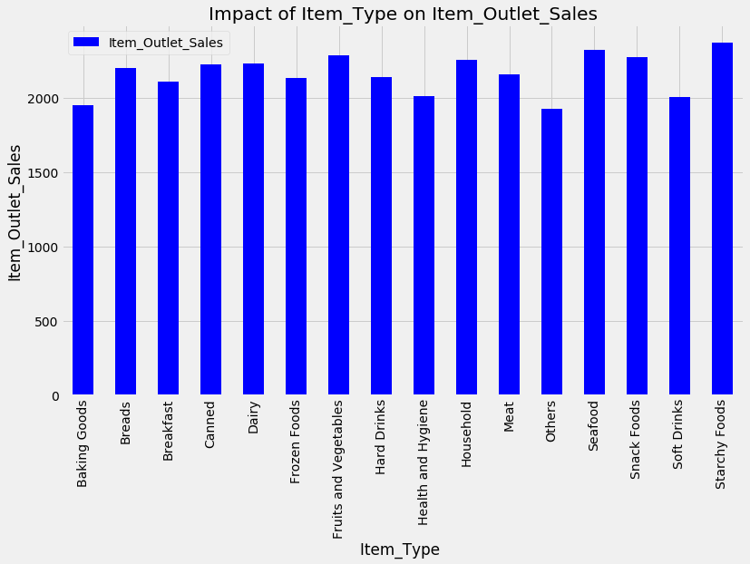

Slide 16
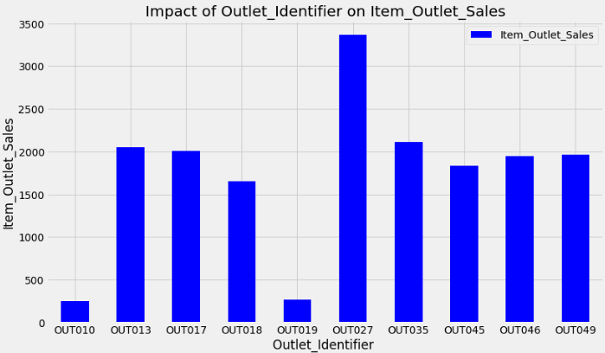
From the below bar chart, we see that the groceries (“OUT010”, “OUT019”) have the lowest sales.

Slide 17
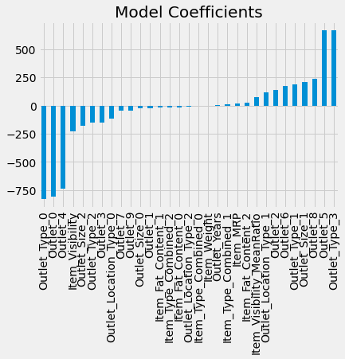
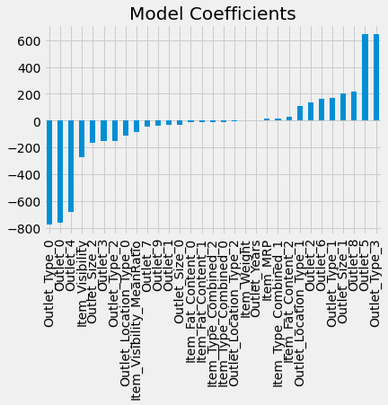
Model Development
Linear Regression
Ridge
Model Report
(Linear Regression)
Accuracy : 56.35 %
RMSE : 1127
Model Report
(Ridge)
Accuracy : 56.25 %
RMSE : 1129

Slide 18
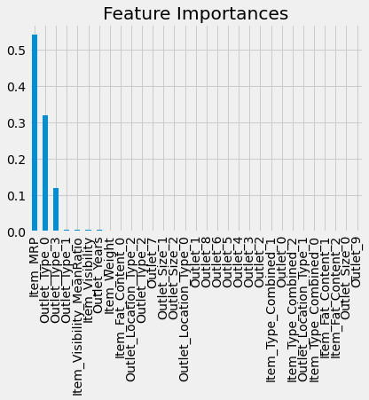
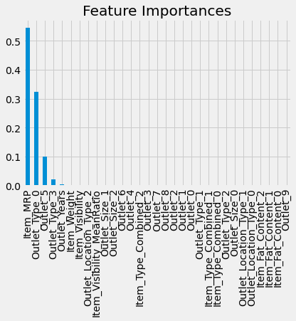
Decision Tree Model
Random Forest Model
Model Report
(Decision Tree)
Accuracy - 61.58 %
RMSE : 1058
Model Report
(Random Forest)
Accuracy - 60.77 %
RMSE : 1069

Slide 19

XGBoost Model
Algorithms | Accuracy
Linear Regression | 56.35%
Ridge Regression | 56.25%
Decision Tree | 61.58%
Random Forest | 60.77%
XGBoost Model | 61.97%
XGBoost is found to be the appropriate algorithm with accuracy of 61.97% according to the collected data and thus fulfilling the aim of this project.

Slide 20
Social Impact (Applications)
A sales forecast helps every business make better business decisions. It helps in overall business planning, budgeting, and risk management.
Ability to focus a sales team on high-revenue, high-profit sales pipeline opportunities, resulting in improved win rates.
Sales forecasts help sales teams achieve their goals by identifying early warning signals in their sales pipeline and course-correct before it’s too late

Slide 21
Thank you!

